Slide 1

BIT 123
GROUP 5 PRESENTATION

Slide 2

AUGMENTED REALITY AND VIRTUAL REALITY

Slide 3
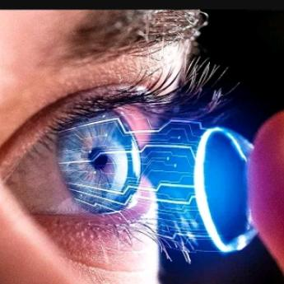
BIT 123 GROUP 5 PRESENTATION
GROUP MEMBERS
ABIGAEL BIYAKI - P100/4236G/23
EVANS MURIIRA - P100/4125G/23
JOSHUA MOKAYA -P100/4242G/23
PAUL GATHUA -P100/4065G/23
DANIEL KIHIU -P100/4216G/23
SHEILA KIPCHUMBA -P100/4217G/23
MERCY MUTUA -P100/4107G/23
LUVEMBE WILBERFORCE –P100/4208G/23
MILTONE OGENDI -P100/4211G/23
DANIEL NYAMAI -P100/4482G/23
JOSEPH MWANGI -P100/4058G/23
BENSON GACHANJA -P100/4079G/23
GILBERT KYALO -P100/4115G/23
HENRICH OWOKO -P100/4222G/23
ANDREA KANG’ETHE -P100/4144G/23
PETER KINGORI -P100/4210G/23
BRENDA CHEROTICH -P100/4149G/23
18. BOAZ KIMUTAI -P100/4987G/23
19. TABITHA WAIRIMU -P100/4184G/23
20. TOMMARK MWENDA -p100/4121G/23
21. LEVIS MUYA -P100/2120G/23
22. SAMSON KIBE -P100/4062G/23
23. IAN KIBIWOT -P100/4229G/23
24. SARAH MARIITA -P100/4518G/23
25. GRACE NYAERAH -P100/4111G/23
26. SAMUEL BUNDI -P100/2133G/22
27. VICTOR KIBET -P100/4944G/23
29.JOSHUA KIMONDIU - P100/4109G/23

Slide 4
DEFINITIONS
  AUGMENTED REALITY
  it overlays digital information onto the real world enhancing the user’s perception of reality. Examples are google maps AR navigation, snapchat filters and AR art (Xiong et al., 2021).
  VIRTUAL REALITY
  immerses users in a completely simulated environment, often through a headset or goggles, blocking out the physical world. Examples are VR gaming, virtual tours and training and simulation (Xiong et al., 2021).

Slide 5
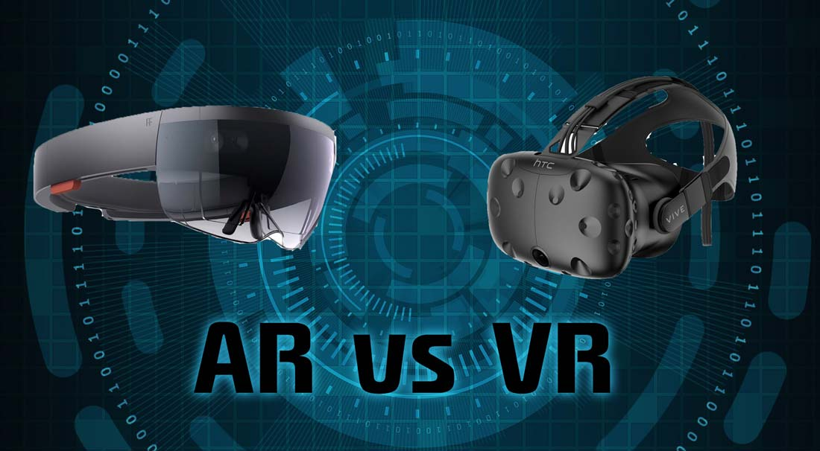
Differences of AR and VR
VR(Virtual reality) | AR(Augmented Reality)
VR is totally imaginary. | AR takes place in the real world.
The system monitors VR users. | AR users have control over their presence in the real world.
VR requires the use of a headset device. | AR is accessible via smartphones.
VR enhances a fictious reality. | AR enhances both the virtual and the real world.

Slide 6

Image Showing Differences of AR and VR

Slide 7
Advantages of Augmented Reality
  Improved Visualization:
  AR allows users to visualize objects, products, and information in real-world environments. This is particularly useful for industries like architecture, interior design, and manufacturing
  Hands-Free Interaction:
  AR applications can be hands-free, allowing users to interact with digital content using gestures, voice commands, or head movements. This is especially beneficial in situations where manual interaction may be impractical or unsafe, such as during surgery or while driving.
  Enhanced Learning and Training:
  Students can explore complex concepts, simulations, and historical events in a dynamic and engaging way, improving retention and understanding.

Slide 8
Advantages of Augmented Reality
    Increased Efficiency and Productivity:
    AR can improve efficiency and productivity in various industries by providing workers with real-time information and guidance. For example, AR-based maintenance and repair solutions can overlay instructions and diagrams onto equipment, reducing downtime and errors.
    Marketing and Brand Engagement:
    AR enhances marketing campaigns by creating interactive and immersive brand experiences. Brands can use AR to engage customers with interactive advertisements, product demonstrations, and virtual try-on experiences, driving brand

Slide 9
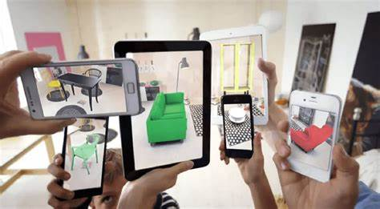
Image of Augmented Reality on Marketing

Slide 10
Disadvantages of Augmented Reality
  Technical Challenges:
  Implementing AR can be technically complex, requiring expertise in computer vision, graphics rendering, and sensor integration. Ensuring smooth and accurate tracking of real-world objects and environments can be challenging, particularly in dynamic or unpredictable conditions
  Health Concerns:
  Prolonged use of AR devices can lead to physical discomfort, such as eye strain, headaches, and fatigue. exposure to AR displays on vision and cognitive health
  Social Disconnection:
  Excessive use of AR devices may lead to social disconnection, as users become absorbed in virtual experiences and neglect real-world interactions. This can have negative impacts on social relationships, communication skills, and mental well-being.

Slide 11
Disadvantages of Augmented Reality
  Dependency and Addiction:
  Like other forms of technology, AR has the potential to become addictive, leading to excessive use and dependency.
  Privacy and Security Risks:
  AR applications often collect and process large amounts of personal data, such as location, behavior, and user preferences. This raises concerns about privacy breaches, data security, and unauthorized access to sensitive information.

Slide 12
Advantages of Virtual Reality
Immersive Experiences:
VR provides users with highly immersive and engaging experiences by simulating realistic three-dimensional environments. This level of immersion allows users to feel present in the virtual environment, enhancing their sense of presence and involvement.
Enhanced Training and Education:
VR is utilized for training in various fields, including healthcare, military, aviation, and manufacturing. Simulated environments enable trainees to practice skills and procedures in a safe and controlled setting, reducing the risk of injury or damage. VR-based education enhances learning experiences by providing interactive and hands-on content, improving retention and understanding.

Slide 13
Advantages of Virtual Reality
Product Visualization and Marketing:
VR enhances product visualization and marketing efforts by creating immersive and interactive experiences for customers. Virtual product demonstrations, virtual showrooms, and virtual try-on experiences allow customers to interact with products in a dynamic and engaging way, driving brand engagement and sales.
Virtual Travel and Tourism:
VR enables virtual travel experiences, allowing users to explore destinations, landmarks, and attractions from anywhere in the world. Virtual tours provide a realistic sense of scale, ambiance, and immersion, enhancing destination marketing efforts and attracting potential travelers.

Slide 14
Disadvantages of Virtual Reality
Health Concerns:
Prolonged use of VR headsets can lead to various health issues, including eye strain, headaches, motion sickness, and fatigue. Some users may also experience discomfort or dizziness due to mismatches between visual and vestibular cues.
Isolation and Social Disconnection:
Immersive VR experiences can lead to social isolation as users become absorbed in virtual environments and neglect real-world interactions. This can have negative impacts on social relationships and communication skills.
Content Space Requirements:
Some VR experiences may require a significant amount of physical space for users to move around safely. This can be challenging for users with limited space at home or in other environments, restricting their ability to fully engage with certain VR applications.

Slide 15
Disadvantages of Virtual Reality
Cost of Equipment:
VR hardware, such as headsets and controllers, can be expensive, making it inaccessible to some users. Additionally, VR-ready computers or gaming consoles may be required to run high-quality VR experiences, further adding to the cost.
Dependency and Addiction:
Like other forms of technology, VR has the potential to become addictive, leading to excessive use and dependency (Villagran-Vizcarra et al., 2023). Users may experience difficulty disconnecting from VR experiences, leading to problems such as decreased productivity, neglect of responsibilities, and withdrawal symptoms when not using VR devices.

Slide 16
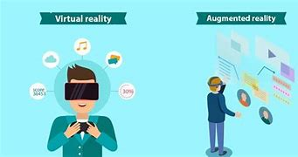
Image showing virtual reality and Augmented Reality

Slide 17
Applications of Augmented Reality
Gaming and Entertainment:
AR gaming applications, like Pokémon GO, have gained widespread popularity by overlaying digital characters and elements onto real-world environments.
Education and Training:
AR enhances learning experiences by providing interactive and engaging educational content. It can be used in classrooms to visualize complex concepts, create interactive textbooks, and facilitate virtual field trips.
Healthcare:
AR is used in healthcare for medical training, surgical planning, and patient education (Yeung et al., 2021). Surgeons can visualize patient anatomy in 3D overlaid onto the surgical site during procedures, improving precision and accuracy.

Slide 18
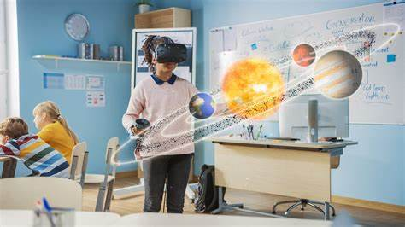
Image showing application of Augmented Reality On Education

Slide 19
Applications of Augmented Reality
Architecture and Design:
AR allows architects, designers, and real estate professionals to visualize building designs and interior layouts in the context of the physical environment. Clients can experience virtual walkthroughs of proposed designs
Marketing and Advertising:
AR enhances marketing campaigns by creating interactive and immersive experiences for consumers. Brands use AR to engage customers with interactive product demonstrations

Slide 20
Applications of Virtual Reality
Gaming and Entertainment:
VR gaming provides immersive experiences where players can interact with virtual environments and characters in three-dimensional space.
Education and Learning:
VR enhances learning experiences by providing immersive and interactive educational content (Lampropoulos et al., 2022). Students can explore historical landmarks and dive into the depths of the ocean.

Slide 21
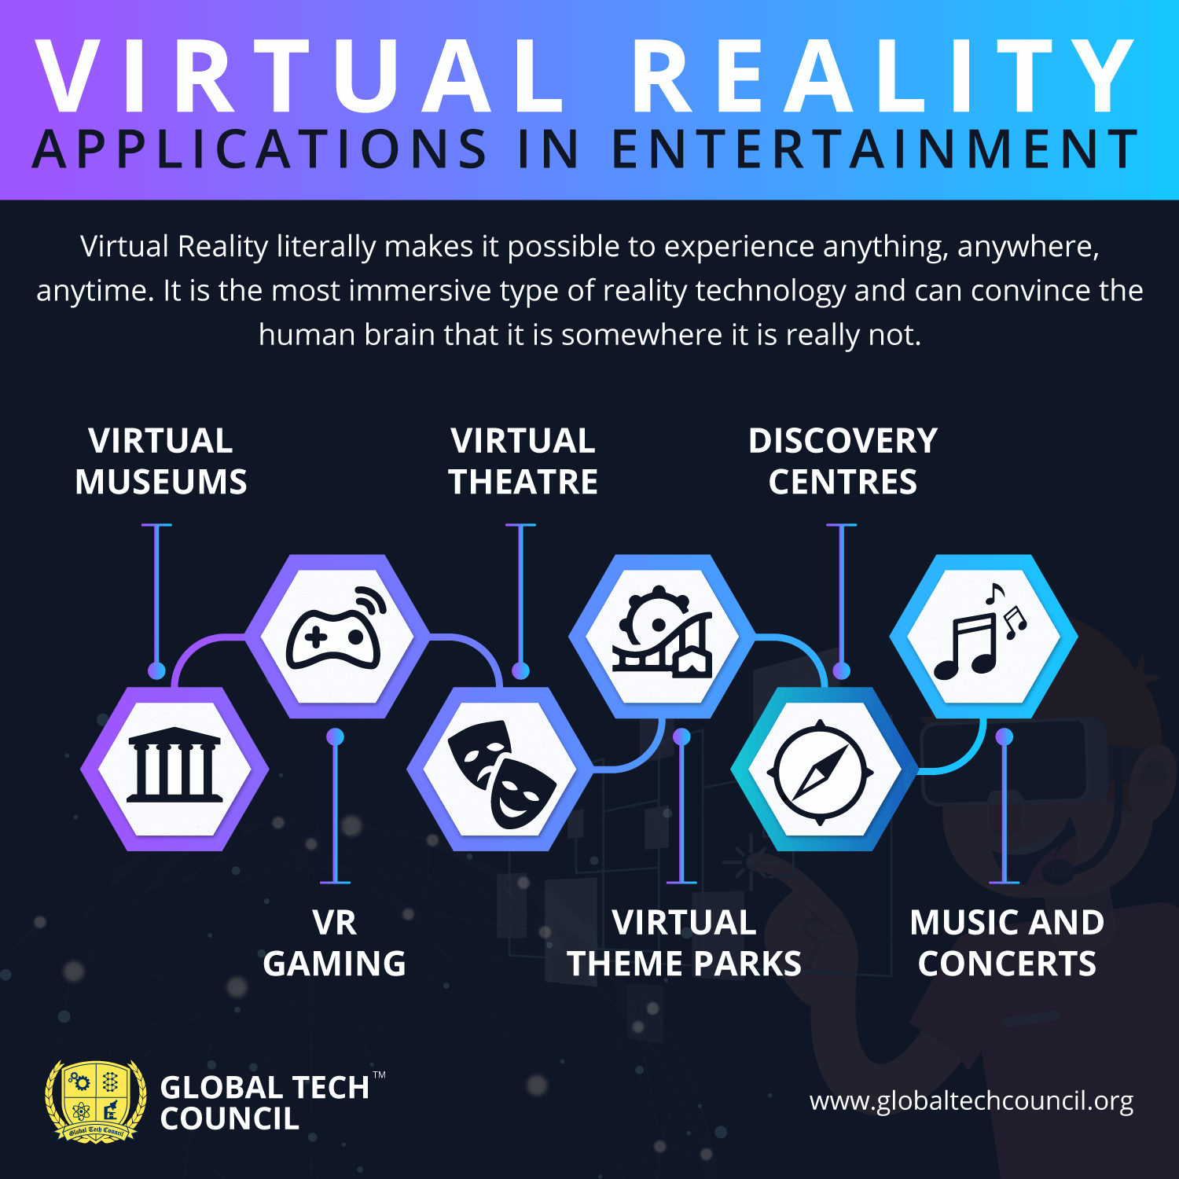

Slide 22
References
Yeung, A. W. K., Tosevska, A., Klager, E., Eibensteiner, F., Laxar, D., Stoyanov, J., ... & Willschke, H. (2021). Virtual and augmented reality applications in medicine: analysis of the scientific literature. Journal of medical internet research, 23(2), e25499.
Lampropoulos, G., Keramopoulos, E., Diamantaras, K., & Evangelidis, G. (2022). Augmented reality and virtual reality in education: Public perspectives, sentiments, attitudes, and discourses. Education Sciences, 12(11), 798.
Villagran-Vizcarra, D. C., Luviano-Cruz, D., Pérez-Domínguez, L. A., Méndez-González, L. C., & Garcia-Luna, F. (2023). Applications Analyses, Challenges and Development of Augmented Reality in Education, Industry, Marketing, Medicine, and Entertainment. Applied Sciences, 13(5), 2766.
Xiong, J., Hsiang, E. L., He, Z., Zhan, T., & Wu, S. T. (2021). Augmented reality and virtual reality displays: emerging technologies and future perspectives. Light: Science & Applications, 10(1), 1-30.

Slide 23


